Slide 1
Web Fundamentals
Bootstrap Framework

Slide 2
Learning Objectives
Understand how frameworks make web design easier
Be able install and use Bootstrap
Be able to import Icons for use in websites
Use pre-built bootstrap features in websites

Slide 3

Bootstrap
Most popular framework in the world – Of all websites queried, Bootstrap is used on 80% of them
Very simple to install and use via CDN (Content Delivery Network)
Extensive documentation and example collection
An externally linked CSS Library
Controls the appearance of a website with classes

Slide 4
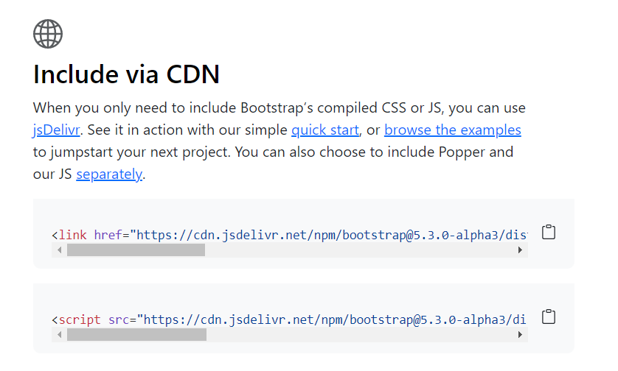
Importing
Added inside a link tag in your <head> section like any other CSS document
This is the most common way, removes the overhead of delivery from your own webserver (if you have one)
Downside is that it relies on the Bootstrap repository to be available at all times
Can be downloaded and customised
getbootstrap.com is the place to start
One is for the CSS Library
The script tag allows for animations and the such

Slide 5
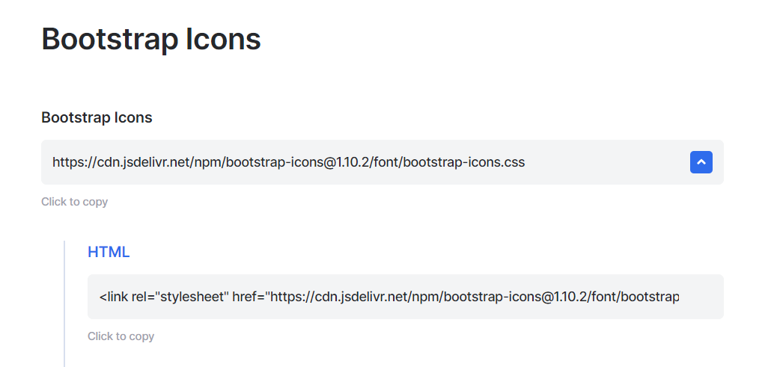
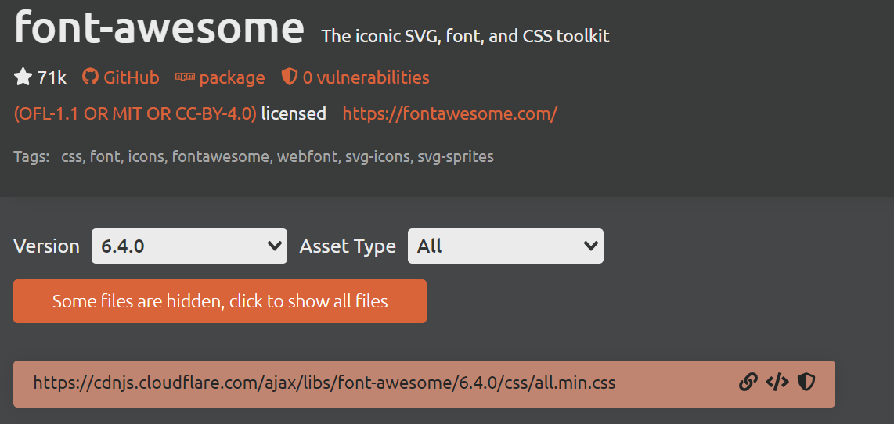
Importing - Icons
Bootstrap and Font Awesome have impressive libraries
Saves time on the creation of your own imagery
Imported in the same way
Pulled into the page with a simple <i> tag

Slide 6
Grid layout
Bootstrap has the default 12 column grid layout
Very easy to define how many columns wide an element should be e.g.
<div class=“col-md-6”>
Some Stuff
</div>
Simply means on a medium screen size, this div should span 6 columns (from a left floated position)
Allows for the webpage to be responsive without the need for media queries

Slide 7
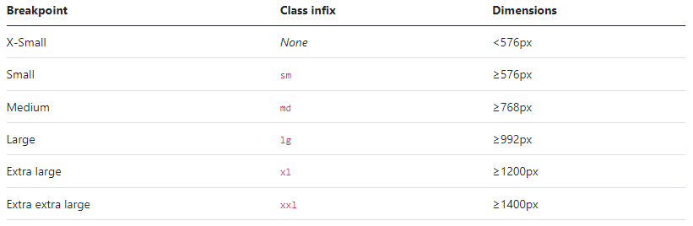
Breakpoints
Bootstrap includes six default breakpoints, sometimes referred to as grid tiers, for building responsively.

Slide 8
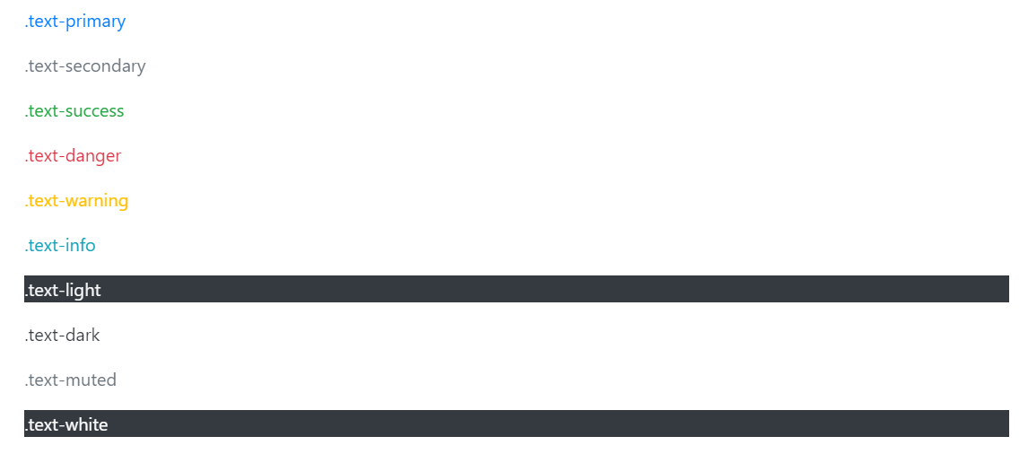
Colours
Bootstrap has a standard set of colours, available for text, button colour, background colour and anywhere else you might want it
<p class="text-primary">.text-primary</p>

Slide 9
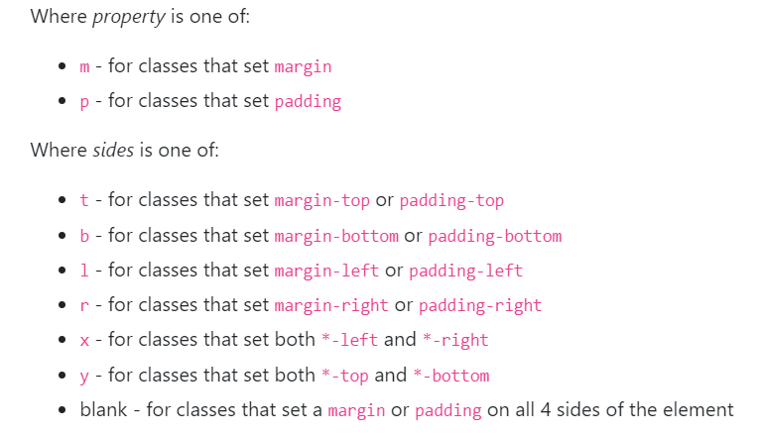
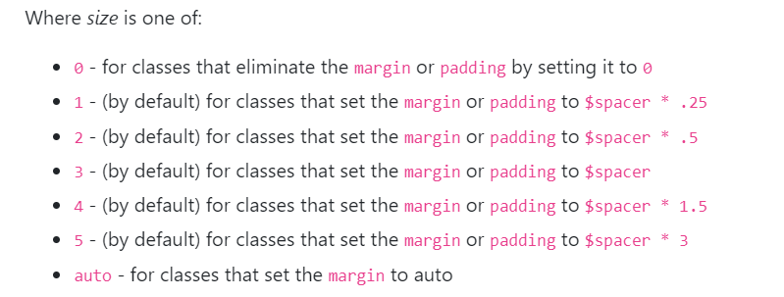
Margins and padding
All spacing is abbreviated for ease
<div class="mb-2">
Simply means this div has a margin on the bottom edge of size 2

Slide 10
Basic layout tricks
Bootstrap makes it easy to separate parts of your website by building containers
Section goes into a container
Grid set up inside the container (same 12 columns)
Row added to separate content
First 3 columns (on a medium Screen) are used
This can be repeated to have 4 items side by side in the same row
<div class="container">
<div class="grid">
<div class="row">
<div class="col-md-3">
CONTENT HERE
</div>
</div>
</div>
</div>

Slide 11
Bootstrap Components

Slide 12
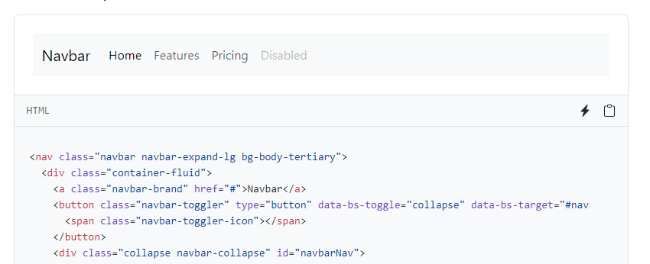
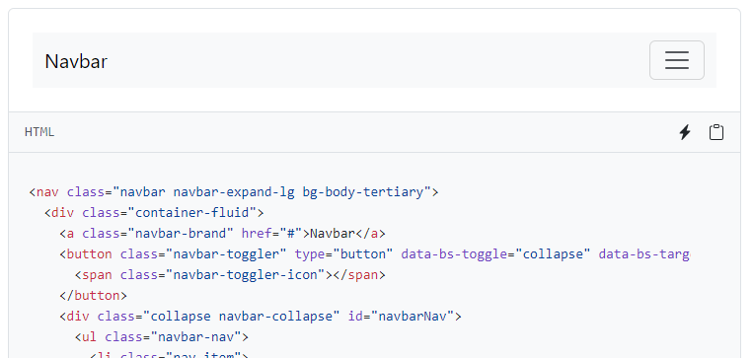
Navbars
Including automatic collapse with screen resize

Slide 13
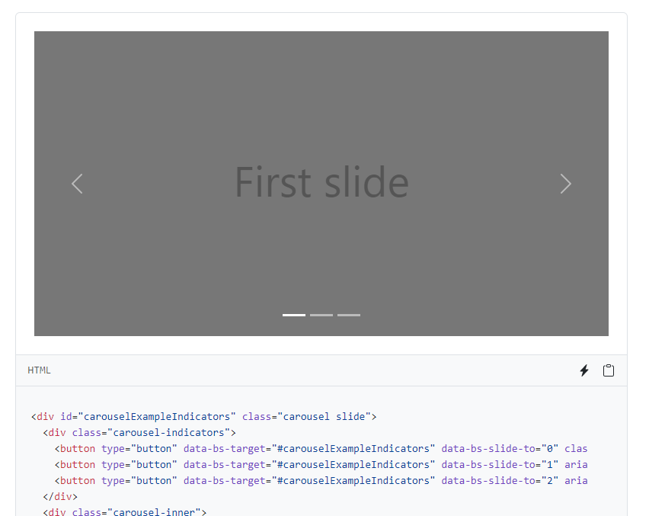
Carousel
Just drop the images into the code and let it do the work

Slide 14
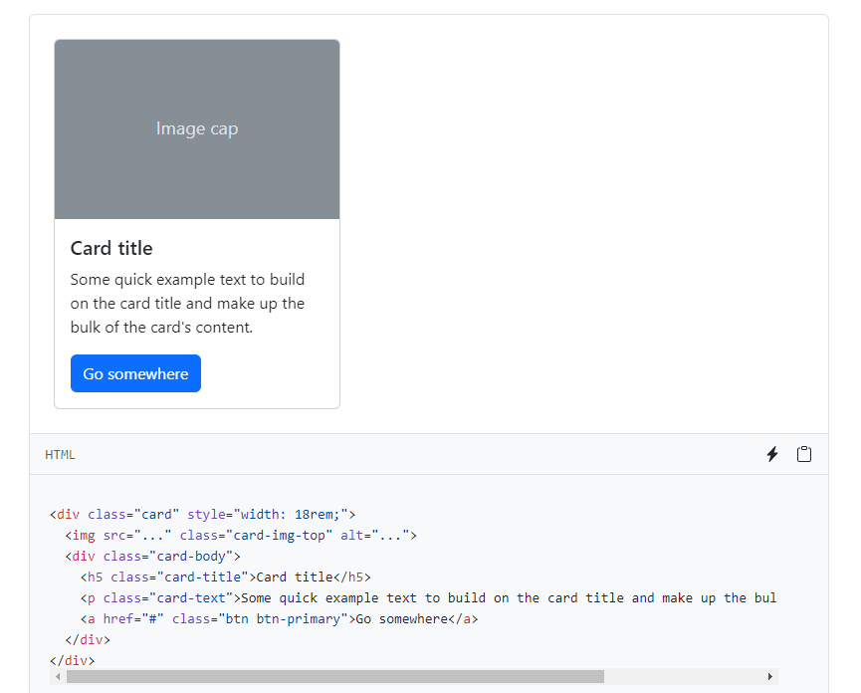
Cards
Repeated sections for similar content

Slide 15
Demonstration

Slide 16
Hackathon – QA Cinemas
You have a brief for a website to be set up using the skills, knowledge and understanding of HTML, CSS and RWD gained on the course
The brief has a number of user stories to tackle
You are expected to:
Have a planning meeting to decide how the work will be distributed
Create the website
Have a review meeting to demonstrate the website to your trainer
Hold a retrospective to review what has been learnt as part of the process

